Slide 1
Tracking Home humidity (Alerts)
SEIS 744-01 IoT
Matthew Lipinski

Slide 2
Humidity & Sleep
A good night’s rest doesn’t just depend on the temperature.
As Minnesotans we are well aware of what humidity is.
We seem to live on both ends of the spectrum.
WINTER
SUMMER

Slide 3
Objective: Humidity Alerts
Use Particle Photon and humidity sensor to get alerts based on room humidity.
I’ll receive alerts based on a humidity threshold set for my bedroom.
Utilize humidifier in the winter and air conditioning in the summer.
Capture humidity data for analysis.

Slide 4
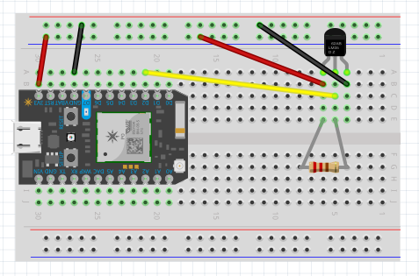
prototyping
Humidity measuring
range: 0-100%RH
Accuracy: ±2%RH
Temperature measuring
Range: -40 °F – 176 °F
Accuracy: ~2 °F

Slide 5
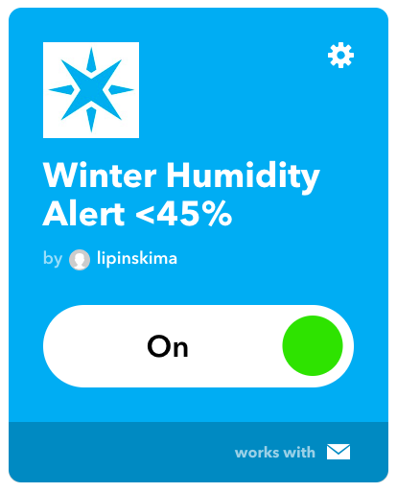
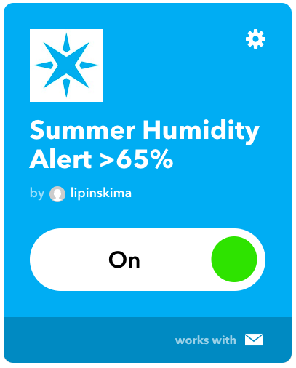
IFTTT

Slide 6
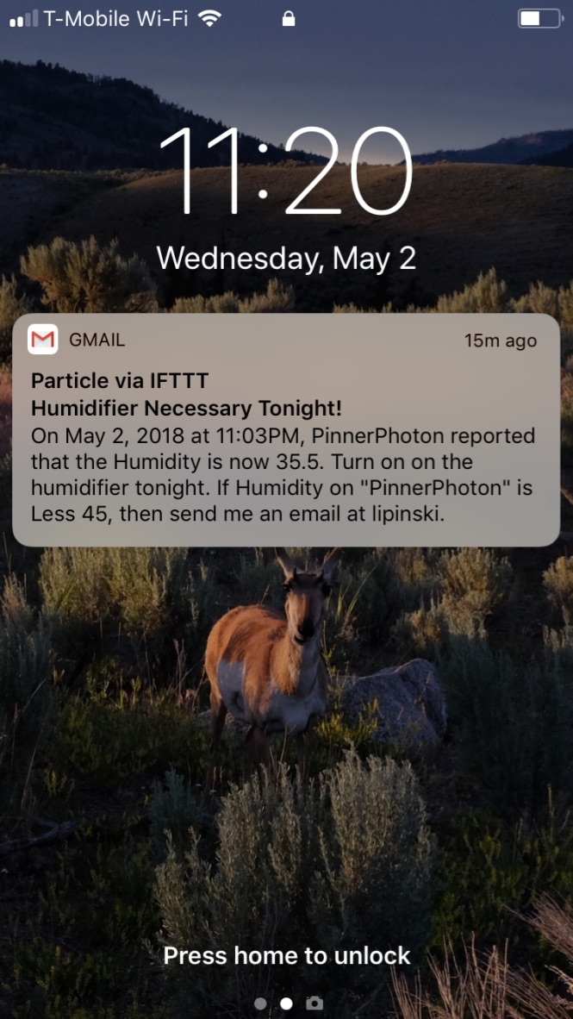
alert

Slide 7
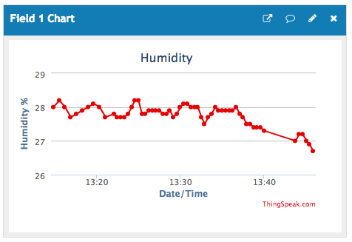
Data
Data Exports (CSV)
Entry ID
Date/Time
Reading
Utilizing ThingSpeak.com

Slide 8
Lessons learned
Complexity of working with hardware, software, and the network.
Reliability of components.
Code integration and customization.

Slide 9
Future considerations
Get additional sensors for other rooms in the house and garage.
Capture and store humidity and temperature data.
Azure IoT Hub or Google Cloud Platform.
Combine home temperature data and local forecast to predict energy usage.
Increase smart home device inventory (as prices continue to decline).
Eventually move into outdoor sensors for gardening.

